Slide 1
MRI System control
pyPico
Temperature control
TNMR
PhantomViewer
pyMRI
ImageView
Study:
tntFiles
Run log
MatLab
TechMag Console

Slide 2
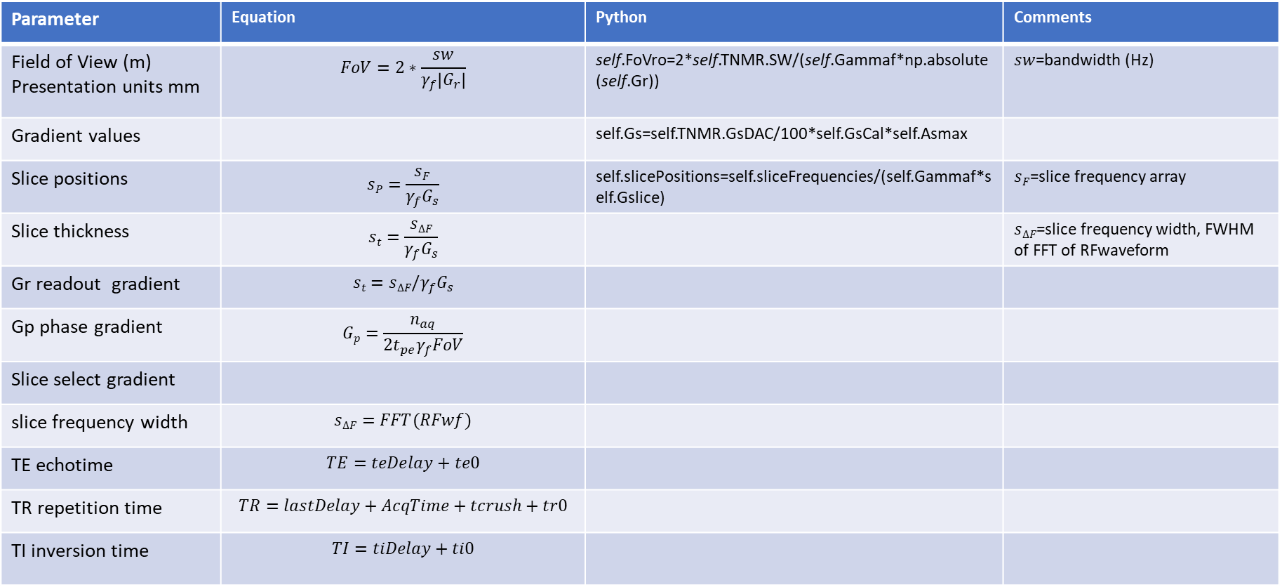
Pulse sequence equations
Parameter | Equation | Python | Comments
Field of View (m) Presentation units mm | $$FoV=2∗\frac{sw}{γ_{f}\left|G_{r}\right|}$$ | self.FoVro=2*self.TNMR.SW/(self.Gammaf*np.absolute(self.Gr)) | $sw$=bandwidth (Hz)
Gradient values |  | self.Gs=self.TNMR.GsDAC/100*self.GsCal*self.Asmax
Slice positions | $$sP=\frac{sF}{γ_{f}G_{s}}$$ | self.slicePositions=self.sliceFrequencies/(self.Gammaf*self.Gslice) | $sF$=slice frequency array
Slice thickness | $$st=\frac{sΔF}{γ_{f}G_{s}}$$ |  | $sΔF$=slice frequency width, FWHM of FFT of RFwaveform
Gr readout gradient | $$st=sΔF/γ_{f}G_{s}$$
Gp phase gradient | $$Gp=\frac{n_{aq}}{{{2t}_{pe}γ}_{f}FoV}$$
Slice select gradient
slice frequency width | $$sΔF=FFT(RFwf)$$
TE echotime | $$TE=teDelay+te0$$
TR repetition time | $$TR=lastDelay+AcqTime+tcrush+tr0$$
TI inversion time | $$TI=tiDelay+ti0$$

Slide 3
Conventions
Sequence parameters:
Gcrush
Gp
Gr
Grr
Gs
Gsr
rfAttn90
rfAttn180
tex1
tex2
Ti
Tpe=phase encode time
tramp=ramp time on all gradients usually 0.5ms
Tspoil+ gradient spoil time at end of sequence ~1ms
Te0
Ti0
tr0
Dimensions:
SEMS, SEMS-IR : 1=slice, 2=average, 3=phase, 4=TI
PS tables:
gRise=0 to 100 rampup
gFall=100 to 0 ramp down
rfShape
rfPhase
GpAmpTbl=phase gradient amplitudes
sliceFrequencies: slice location frequecies
sliceF0=sets slice frequency back to 0

Slide 4
Refocusing pulses

Slide 5
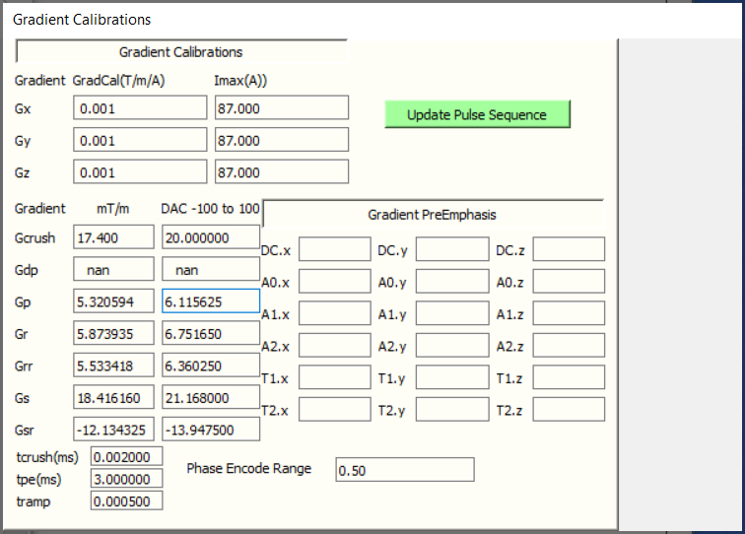
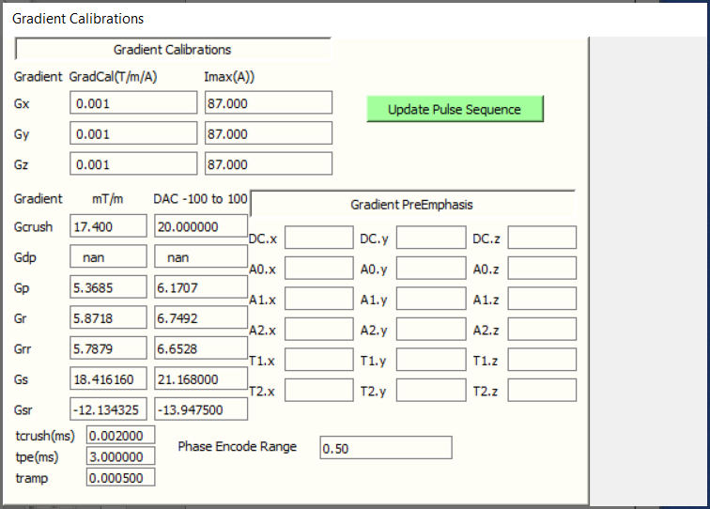

Slide 6
